Slide 1
Automating Separation Logic with Trees and Data
Ruzica Piskac
Yale University
Thomas Wies
New York University
Damien Zufferey
MIT CSAIL
CAV, 22.07.2014, Vienna

Slide 2
Motivation: extracting max element in a BST
procedure extract_max(root: Node, pr: Node)
returns (new_root: Node, max: Node)
{
var c, m: Node;
if (root.right != null) {
c, m := extract_max(root.right, root);
root.right := c;
return root, m;
} else {
c := root.left;
root.parent := null;
if (c != null) c.parent := pr;
return c, root;
}}
0
6
0
6

Slide 3
Motivation: extracting max element in a BST
procedure extract_max(root: Node, pr: Node)
returns (new_root: Node, max: Node)
{
var c, m: Node;
if (root.right != null) {
c, m := extract_max(root.right, root);
root.right := c;
return root, m;
} else {
c := root.left;
root.parent := null;
if (c != null) c.parent := pr;
return c, root;
}}
p
r
m

Slide 4
Motivation: extracting max element in a BST
procedure extract_max(root: Node, pr: Node)
returns (new_root: Node, max: Node)
{
var c, m: Node;
if (root.right != null) {
c, m := extract_max(root.right, root);
root.right := c;
return root, m;
} else {
c := root.left;
root.parent := null;
if (c != null) c.parent := pr;
return c, root;
}}
p
r

Slide 5
Motivation: extracting max element in a BST
procedure extract_max(root: Node, pr: Node)
returns (new_root: Node, max: Node)
{
var c, m: Node;
if (root.right != null) {
c, m := extract_max(root.right, root);
root.right := c;
return root, m;
} else {
c := root.left;
root.parent := null;
if (c != null) c.parent := pr;
return c, root;
}}
Memory safety
Preserve shape of trees
Functional correctness
Preserve frame
0
6
Notes:
Get frame reasoning for free if uses separation logic

Slide 6

Trees in SL
$$Tree\left(x\right) ≔ x=null$$
$∨$ $acc\left(x\right)∗ Tree\left(x.l\right) ∗Tree(x.r)$
Allocated (access)
Separating conjunction
x
l
r

Slide 7

Motivation: extracting max element in a BST
procedure extract_max(root: Node, pr: Node)
returns (new_root: Node, max: Node)
requires bst(root, pr) * root $≠$ null;
ensures bst(new_root, pr) * acc(max);
ensures max.right = null $∧$ max.parent = null;
{ … }
Non-empty binary search tree
Binary search tree and a single node

Slide 8
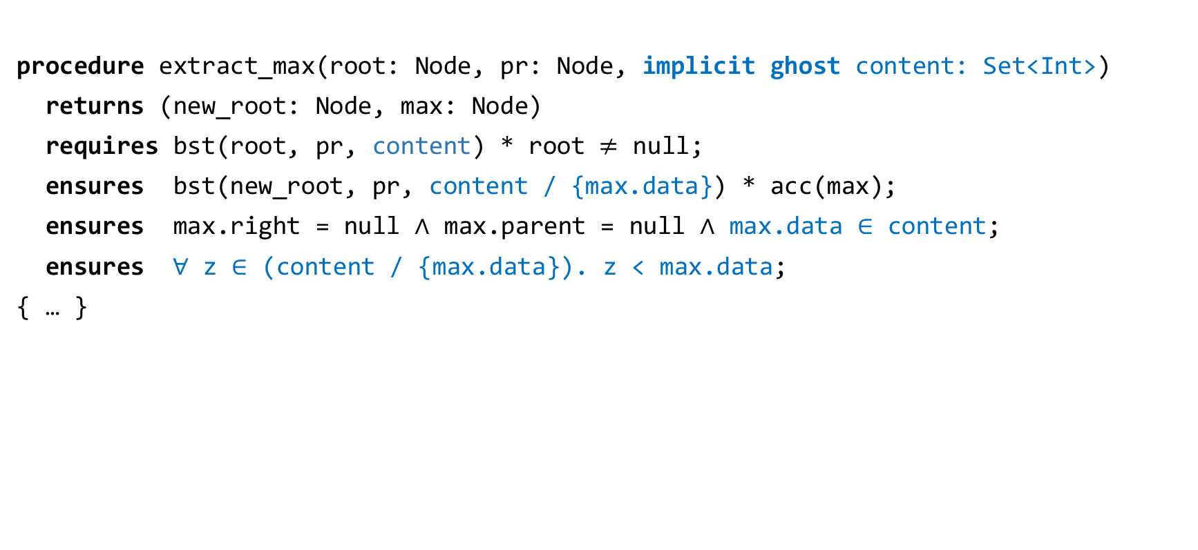
Motivation: extracting max element in a BST
procedure extract_max(root: Node, pr: Node, implicit ghost content: Set<Int>)
returns (new_root: Node, max: Node)
requires bst(root, pr, content) * root $≠$ null;
ensures bst(new_root, pr, content / {max.data}) * acc(max);
ensures max.right = null $∧$ max.parent = null $∧$ max.data $∈$ content;
ensures $∀$ z $∈$ (content / {max.data}). z < max.data;
{ … }

Slide 9
Existing approaches to reasoning about SL with trees
Unrolling inductive definitions [Nguyen et al. 07, Qiu et al. 13]
Advantages: conceptually simple and efficient
Limitation: incompleteness
Reduction to MSOL [Iosif et al. 13]
Advantage: complete
Limitations: high complexity, non trivial extensions with data
Other approaches not targeting SL
Limitations: global assumptions about structure of the heap

Slide 10
Limitation of unfolding based methods
procedure contains(root: Node, val: Int)
returns (res: Bool)
requires tree(root);
ensures tree(root);
{
var curr: Node := root;
while (curr != null && curr.data != val)
invariant ???;
{
if (curr.data < val) { curr := curr.left; }
else if (curr.data > val) { curr := curr.right; }
}
if (curr != null) return true;
else return false;
}
root
curr
Notes:
Complex predicate: tree with hole (unfolding fall apart, does not follow the induction structure)

Slide 11
Contributions
A decision procedure for a fragment of SL with trees and data
Complete
“Low” complexity (NP-complete)
SMT-based (allows for combination with other theories)
Implemented in the GRASShopper tool
Functional correctness of tree based data structure

Slide 12
Limitation of unfolding based methods
procedure contains(root: Node, val: Int)
returns (res: Bool)
requires tree(root);
ensures tree(root);
{
var curr: Node := root;
while (curr != null && curr.data != val)
invariant tree(curr) -** tree(root);
{
if (curr.data < val) { curr := curr.left; }
else if (curr.data > val) { curr := curr.right; }
}
if (curr != null) return true;
else return false;
}
root
“Russian dolls” operator
curr
Notes:
Magic wand for free, because of completeness we don’t need to worry about the induction

Slide 13
Reducing SL to First Order Logic
Notes:
For an SMt-based technique, we need to reduce SL to FOL

Slide 14
SL to First Order Logic [Piskac et al. 13]
formula
SL
precise fragment
structure
footprint
FOL
decidable fragment
reachability
sets
For entailment queries: negate only
We provide a target logic, called GRIT, for SL of trees
Notes:
Precise = footprint uniquely defined
GRIT = graph reach and inverted tree

Slide 15
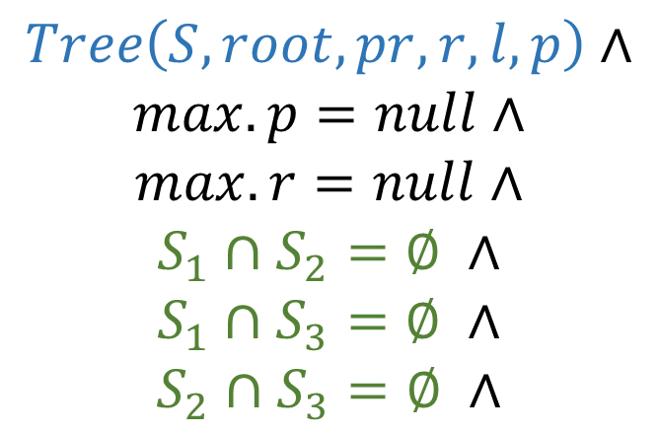
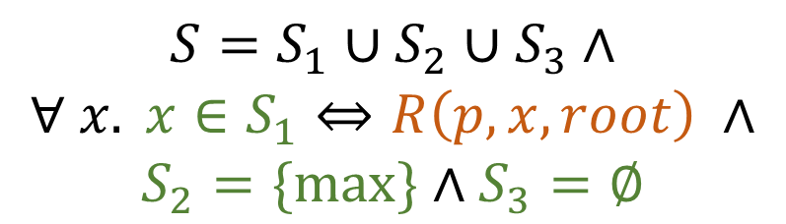
Example of the Translation
$$Tree\left(root, pr\right)∗acc\left(max\right)∗(max.r=null∧max.p=null)$$
$$Tree\left(S, root, pr, r,l,p\right)∧$$
$$max.p=null∧$$
$$max.r=null∧$$
$$S_{1}∩S_{2}=∅ ∧$$
$$S_{1}∩S_{3}=∅ ∧$$
$$S_{2}∩S_{3}=∅ ∧$$
$$S=S_{1}∪S_{2}∪S_{3}∧$$
$$∀ x. x∈S_{1}⇔R\left(p, x, root\right) ∧$$
$$S_{2}=\{\max{\}}∧S_{3}=∅$$
Notes:
Highlight the different parts of the logic: preds, reach, sets, …

Slide 16
Decision Procedure

Slide 17
Backward Reachability
t₁
t₁
l
r
p
p
(l,r)*
p*
l
r
l
r
p
p
p
p
t₂
t₂
Reasoning using backward reachability [Balaban et al. 07]
Allows us to use work on reachability logics [Rakamaric et al. 07, Lahiri & Qadeer 08]
Axiomatization of Tree in terms of reachability predicates, based on [Wies et al. 11]
Notes:
CADE paper:
-made it work in practice
-made it work with SL

Slide 18

Axioms: definition of the footprint
$$∀x. x∈S⇔R(p, x, root)$$
root
null
p*
x

Slide 19

Axioms: p inverse of l
$$∀ x∈S. x.l=null∨R\left(p, x.l, x\right)$$
x
l
p*
$≠$null

Slide 20


Axioms: l and r descendants
$$∀ x, y. y∈S∧R\left(p,x,y\right)⇒x=y∨B\left(p, x, y.l, y\right)∨B\left(p, x, y.r, y\right)$$
y
y
y
l
r
$$∨$$
$$∨$$
x,y
p*
p*
p*
x
x
x

Slide 21
Underlying Principle
Based on local theory extensions [Sofronie-Stokkermans, CADE’05]
Reasoning done on partial models
p*
p
l,r
Notes:
Add poly #terms to be complete

Slide 22
Extensions with Data
Notes:
We give three recipe to handle data that fits well into the decision procedure

Slide 23
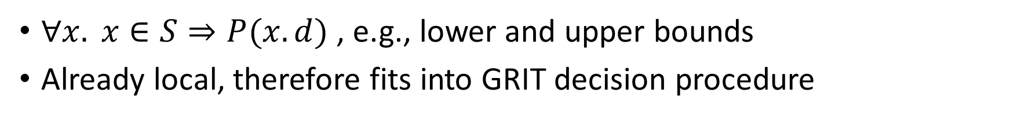
Monadic predicates
$∀x. x∈S⇒P(x.d)$ , e.g., lower and upper bounds
Already local, therefore fits into GRIT decision procedure
3
Apply the axioms to each term in the formula
3
2
2
1
1

Slide 24
Binary predicates
Needs to be transitive (generalize to reachability)
Sorted trees are ok
Trees with height are not
0
1
2
3
Reasoning on partial model
0
3

Slide 25






Set projection
The content of a tree: $C=\left\{ v \right| ∃ x∈S. x.d=v \}$
Introduce a $witness(d,v,C)$ Skolem fct with a local axiomatization
$$C=\left\{ 0, 2, 3\right\}$$
2
$witness(d,2,C)$
null
$witness(d,1,C)$
0
3
$witness(d,3,C)$
$witness(d,0,C)$

Slide 26
Experiments
GRASShopper
https://cs.nyu.edu/wies/software/grasshopper/
Tested on tree data structures:
binary search trees
skew heaps
union-find (inverted trees)
Show memory safety and functional correctness for basic operations
Operations: from 8 to 77 LOC, spec from 3 to 7 lines
Solving time: median=3s, average = 33s, max = 361s
Detailed results in the paper
Notes:
Size are for individual procedure

Slide 27
Contributions
In this paper, we introduced:
An NP-decision procedure for a fragment of SL with trees and data
SMT-based decision procedure allows for combination with other theories
Implemented in the GRASShopper tool
https://cs.nyu.edu/wies/software/grasshopper/

Slide 28
Related Work
SL inductive definitions of bounded tree-width [Iosif et al. 13]
MSOL [Thatcher & Wright 68, Klarlund & Møller 01]
Reachability and data: [Bouajjani et al. 09, Madhusudan et al. 11]
Tools for proving functional correctness of linked data structures: Bedrock [Chlipala 13], Dafny [Leino 13], Jahob [Zee et al. 08], HIP/SLEEK [Nguyen et al. 07], and VeriFast [Jacobs et al. 11].
…

Slide 29
Axioms: no non-trivial cycles
$$∀ x,y∈S. R\left(p,x,y\right)∧R\left(p,y,x\right)⇒x=y$$
x
x,y
p*
y

Slide 30

Axioms: nothing between parent and child
$$∀ x∈S, y. B\left(p, x.l, y, x\right)⇒y=x∨ y=x.l$$
x
x
x,y
p*
$$∨$$
l
y
l
p*
l
p*
y

Slide 31
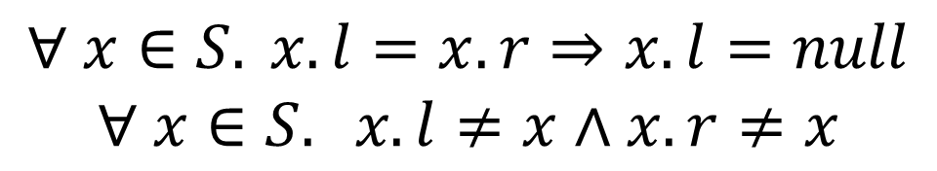
Axioms: children distinct
$$∀ x∈S. x.l=x.r⇒x.l=null$$
$$∀ x∈S. x.l≠x∧x.r≠x$$
x
l,r
l,r
x
null

Slide 32
First Common Ancestor
fca(p,x,y)
x
y
x
y
Needed to make sure we can build trees from partial models

Slide 33
GRASShopper: experimental results 1
Data structure | Procedure | # LOC | # L spec | # L ghost | #VCs | Time in s
Set as binary tree Functional correctness | Contains | 17 | 3 | 3 | 9 | 3
 | Destroy | 8 | 2 | 2 | 7 | 1
 | Extract_max | 14 | 5 | 3 | 9 | 20
 | Insert | 24 | 2 | 3 | 15 | 61
 | Remove | 33 | 2 | 11 | 35 | 117
 | Rotate (l,r) | 8 | 3 | 4 | 11 | 15
Set as sorted list Functional correctness | Contains | 15 | 7 | 6 | 4 | 1
 | Delete | 26 | 7 | 6 | 8 | 12
 | Difference | 20 | 3 | 1 | 15 | 13
 | Insert | 25 | 7 | 6 | 8 | 69
 | Union | 20 | 3 | 1 | 15 | 15

Slide 34
GRASShopper: experimental results 2
Data structure | Procedure | # LOC | # L spec | # L ghost | #VCs | Time in s
Union-find (tree view) Functional correctness | Find | 12 | 2 | 1 | 4 | 0.2
 | Union | 10 | 3 | 1 | 4 | 0.3
 | Create | 11 | 3 | 0 | 3 | 0.1
Union-find (list view) Path compression | Find | 12 | 3 | 1 | 4 | 0.1
 | Union | 9 | 7 | 1 | 4 | 3
 | Create | 10 | 1 | 0 | 3 | 0.1
Skew heap Shape, heap property | Insert | 17 | 2 | 2 | 7 | 0.3
 | Union | 11 | 2 | 4 | 12 | 35
 | Extract_max | 9 | 2 | 1 | 11 | 6
And some more examples using loops …

Slide 35
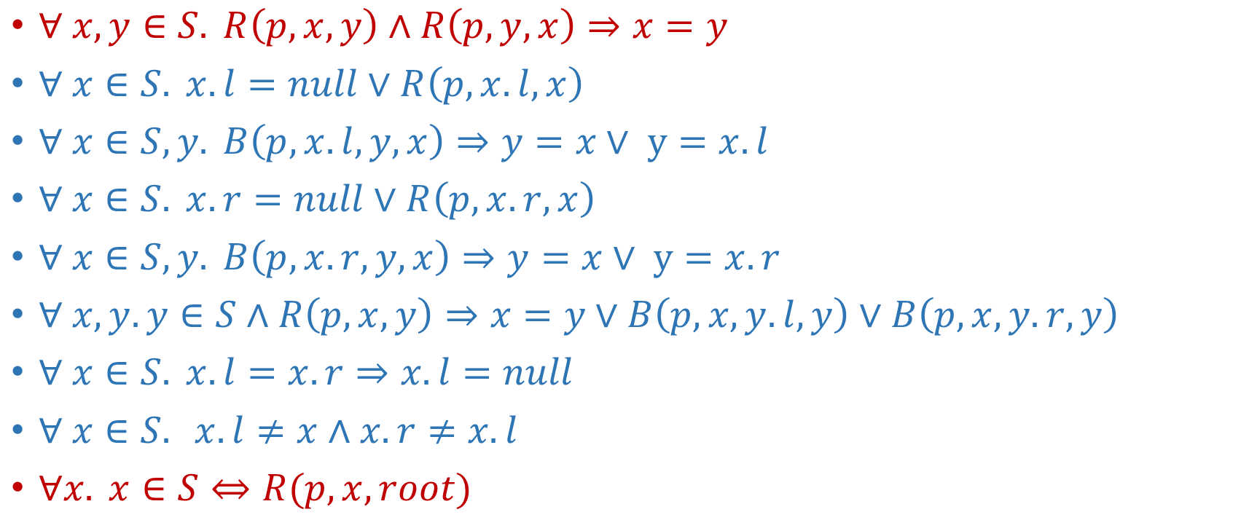
Axiomatization of GRIT
$∀ x,y∈S. R\left(p,x,y\right)∧R\left(p,y,x\right)⇒x=y$
$∀ x∈S. x.l=null∨R\left(p, x.l, x\right)$
$∀ x∈S, y. B\left(p, x.l, y, x\right)⇒y=x∨ y=x.l$
$∀ x∈S. x.r=null∨R\left(p, x.r, x\right)$
$∀ x∈S, y. B\left(p, x.r, y, x\right)⇒y=x∨ y=x.r$
$∀ x, y. y∈S∧R\left(p,x,y\right)⇒x=y∨B\left(p, x, y.l, y\right)∨B\left(p, x, y.r, y\right)$
$∀ x∈S. x.l=x.r⇒x.l=null$
$∀ x∈S. x.l≠x∧x.r≠x.l$
$∀x. x∈S⇔R(p, x, root)$

Slide 36
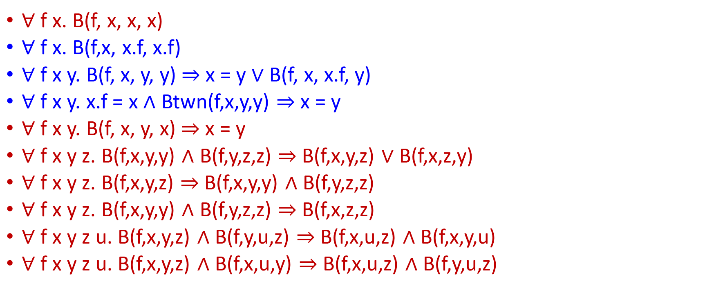
First-Order Axioms for B(etween)
$∀$ f x. B(f, x, x, x)
$∀$ f x. B(f,x, x.f, x.f)
$∀$ f x y. B(f, x, y, y) $⇒$ x = y $∨$ B(f, x, x.f, y)
$∀$ f x y. x.f = x $∧$ Btwn(f,x,y,y) $⇒$ x = y
$∀$ f x y. B(f, x, y, x) $⇒$ x = y
$∀$ f x y z. B(f,x,y,y) $∧$ B(f,y,z,z) $⇒$ B(f,x,y,z) $∨$ B(f,x,z,y)
$∀$ f x y z. B(f,x,y,z) $⇒$ B(f,x,y,y) $∧$ B(f,y,z,z)
$∀$ f x y z. B(f,x,y,y) $∧$ B(f,y,z,z) $⇒$ B(f,x,z,z)
$∀$ f x y z u. B(f,x,y,z) $∧$ B(f,y,u,z) $⇒$ B(f,x,u,z) $∧$ B(f,x,y,u)
$∀$ f x y z u. B(f,x,y,z) $∧$ B(f,x,u,y) $⇒$ B(f,x,u,z) $∧$ B(f,y,u,z)

Slide 37
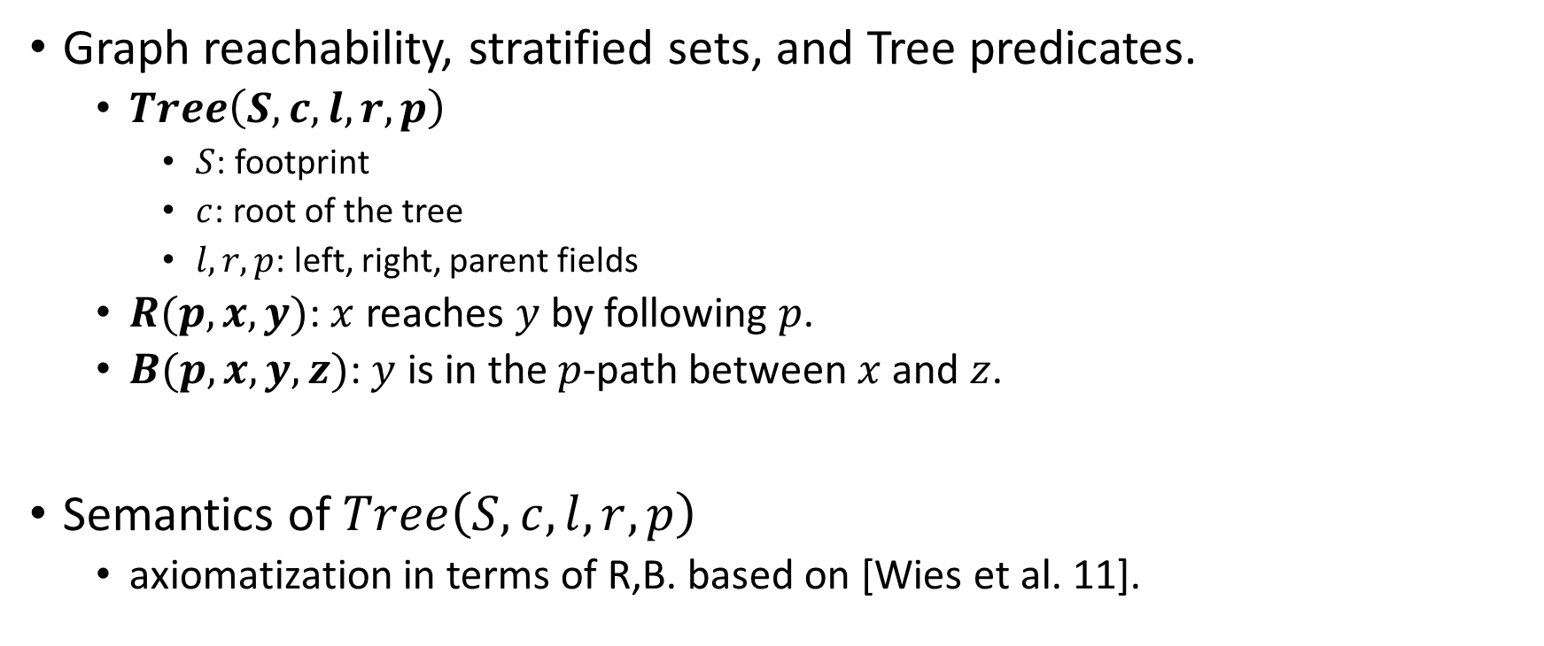
Graph Reachability and Inverted Trees (GRIT)
Graph reachability, stratified sets, and Tree predicates.
$Tree\left(S, c, l,r,p\right)$
$S$: footprint
$c$: root of the tree
$l,r,p$: left, right, parent fields
$R(p,x,y)$: $x$ reaches $y$ by following $p$.
$B(p,x,y,z)$: $y$ is in the $p$-path between $x$ and $z$.
Semantics of $Tree\left(S, c, l,r,p\right)$
axiomatization in terms of R,B. based on [Wies et al. 11].

Slide 38
Motivation for SMT-based SL reasoning
 | Frontend / Specification | Backend / Solver
SL | + succinct + intuitive | - tailor-made solvers - difficult to extend + local reasoning (frame inference)
FOL | + flexible - complex | + standardized solvers (SMT-LIB) + extensible (e.g. Nelson-Oppen)
Strong theoretical guarantees: sound, complete, tractable complexity (NP)
Mixed specs: escape hatch when SL is not suitable.

